Slide 1
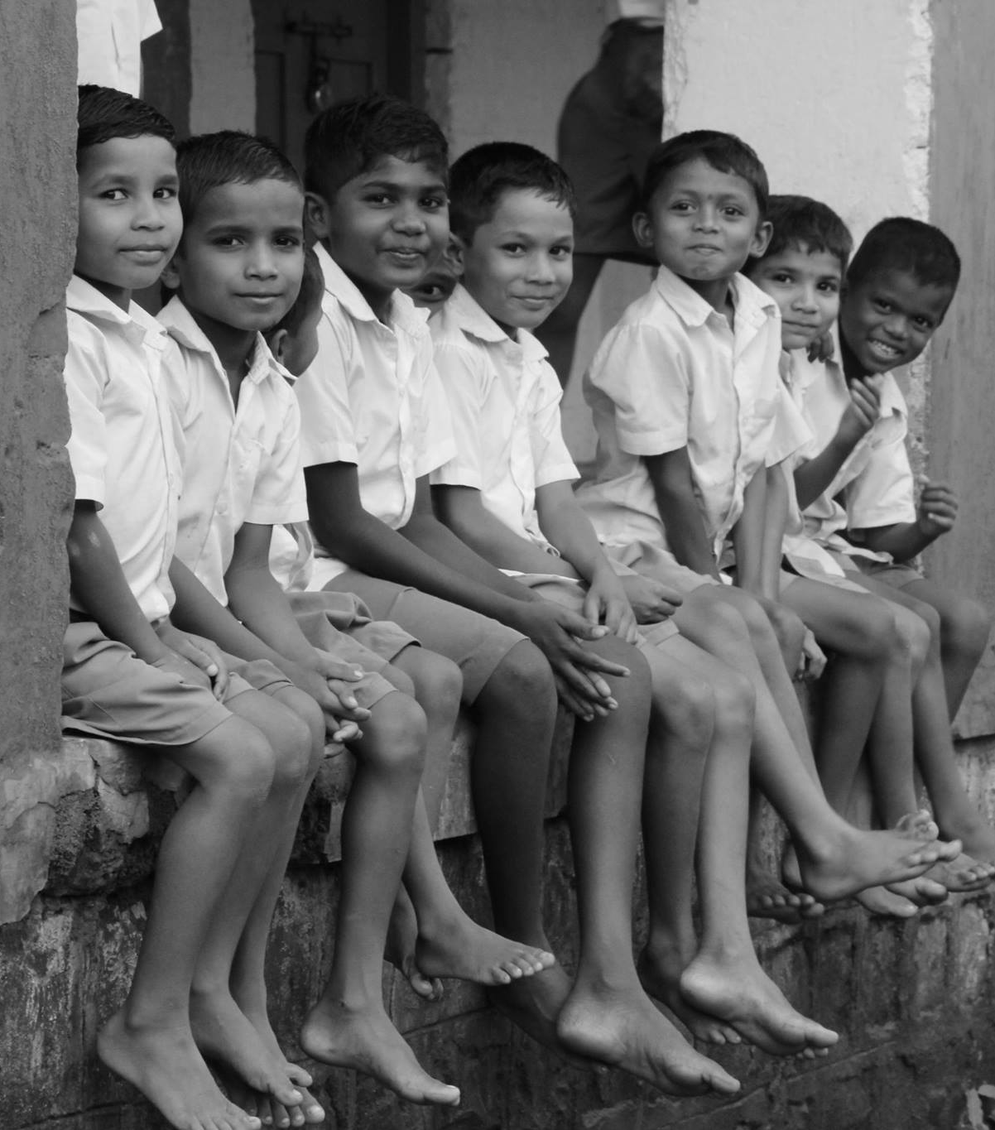
Role of Technology in Promoting Financial Inclusion
Lessons from India
[Academic Report]
by -
Ratul Rana
Sumitomo Mitsui Banking Corporation* [Singapore]
Shotaro Kumagai
Japan Research Institute* [Tokyo]
* Sumitomo Mitsui Financial Group (SMFG) companies

Slide 2




About the Authors
SHOTARO KUMAGAI
RATUL RANA
Sumitomo Mitsui Financial Group (SMFG) companies

Slide 3
SECTIONS
01
02
03
04
.
05
Introduction
India’s efforts towards Financial Inclusion
Aadhaar : Game Changer for India
Strategic Framework for Financial Inclusion in Cambodia : Suggested Approach
Conclusion

Slide 4
MESSAGES, that we bring…
Integrated approach
(Regulatory framework, IT Infrastructure, Identification system, various Social Schemes & Programs …)
Partnerships
(Government, Financial Institutions, Development Partners, MNOs, ISPs, Global IT firms, Card networks….)
Developing an ECOSYSTEM
Using Biometric Identity
e-KYC, Simple and Secured transactions
Reducing operating costs; Improving TAT
Digitizing G2P“ Social Cash” Transfers
SAVINGS for Government; Promoting Good Governance; Creating ‘Banking habit’ for B-o-P

Slide 5
FINANCIAL INCLUSION, as we understand…
PAYMENTs
(commoditised)
CREDIT
(affordable)
INSURANCE
(health; crop;
livestock)
REMITTANCE
(low cost)
SAVINGs
(remunerative)
PENSION
(linked products)
INVESTMENTs
(Unit Trust
scheme)
‘unbanked’ population
vulnerable segment
weaker section & women
low income group

Slide 6

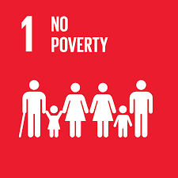
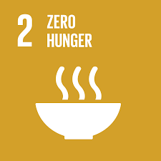















WHY should we focus on FINANCIAL INCLUSION?
Note. http://www.uncdf.org/financial-inclusion-and-the-sdgs

Slide 7
DEMAND side CHALLENGEs…
& SUPPLY
low levels of financial literacy
physical access and poor infrastructure
economic disincentive
lack of suitable
financial products
social stigma associated with borrowing
perception : poor not bankable

Slide 8
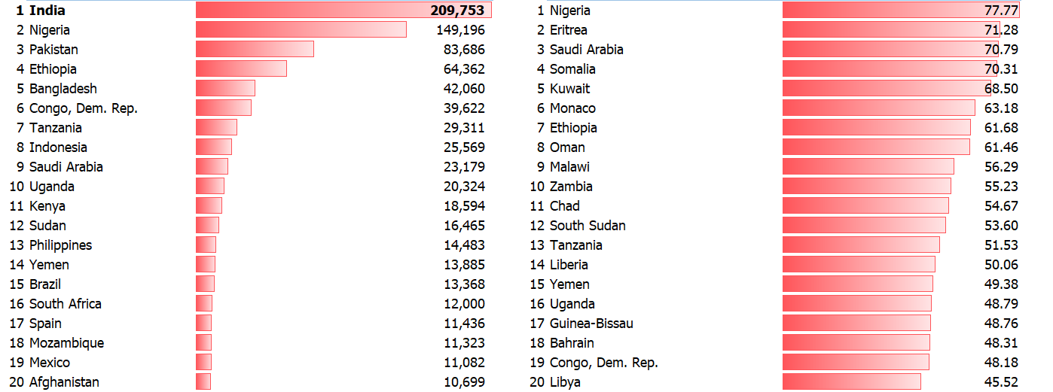
…yet the BIGGEST CHALLENGE is
1.1+ BILLION
cannot prove IDENTITY
Total Estimated Unidentified Population (k)
% Country Population without ID
Note. Position as on June 2017 [https://data.worldbank.org/data-catalog/id4d-dataset]

Slide 9
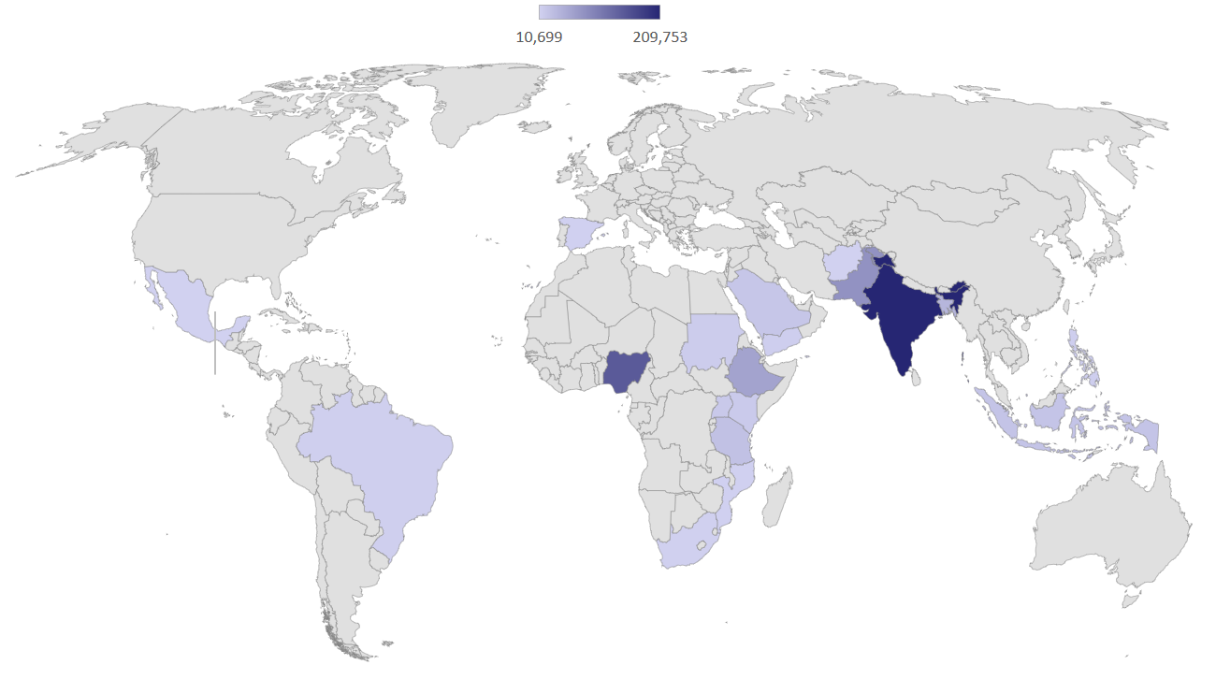
‘INVISIBLE’ people. Where do they live?
Note. Position as on June 2017 [https://data.worldbank.org/data-catalog/id4d-dataset]

Slide 10
‘ID4D : Making EVERYONE COUNT’ [World Bank]
2.4 1.5 1.1
2015
2016
2017

Slide 11
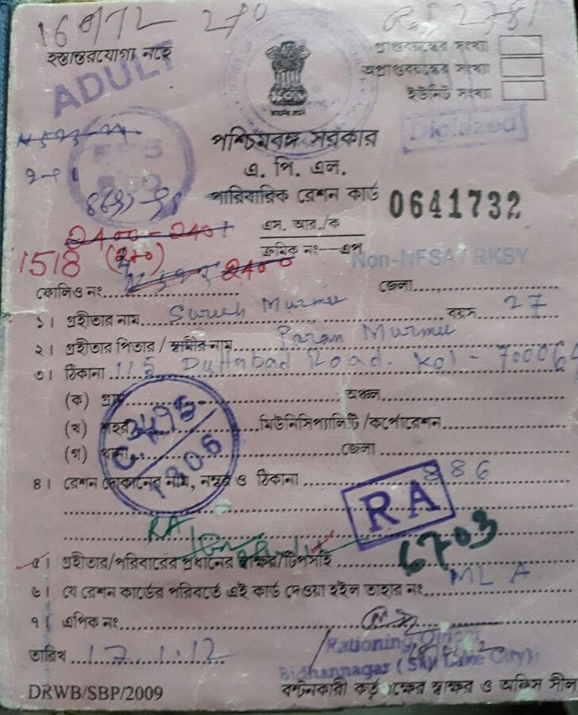
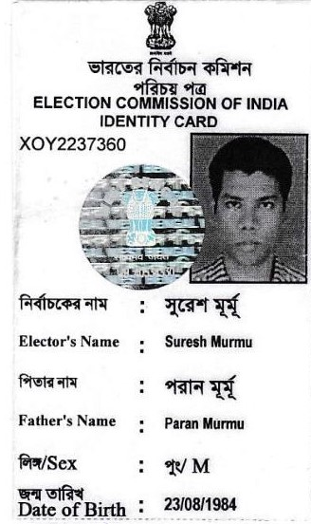
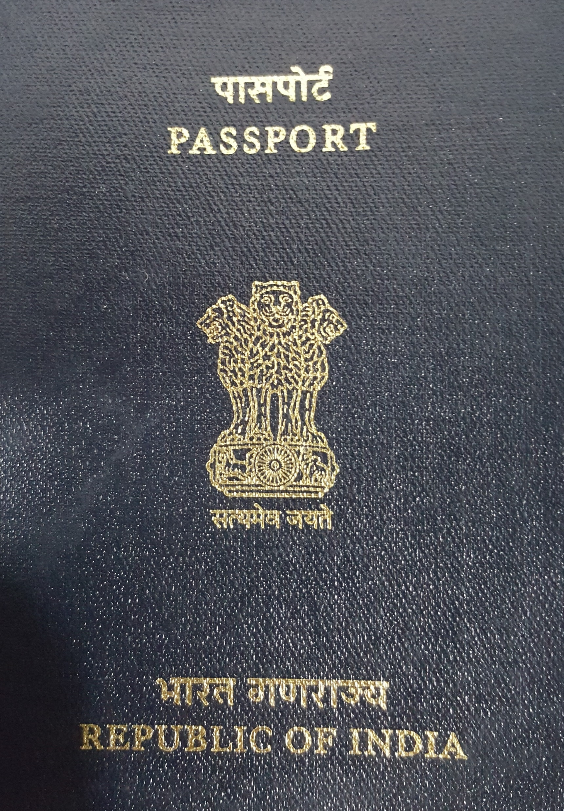
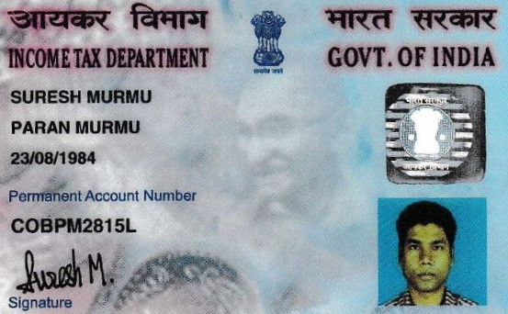
CASE-in-POINT : INDIA then…
[1.2 billion people in 2010-2011]
220 million
500 million
40 million
70 million
SAMPLE
SAMPLE
SAMPLE
Passport
Permanent Account Numbers (PAN)
Ration Card
(for Below Poverty Line)
Voter’s ID
700 million
‘Invisible’

Slide 12
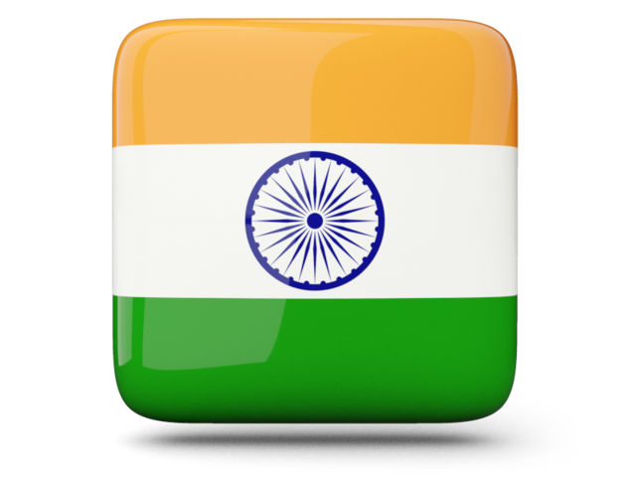
CASE-in-POINT : INDIA today…
1.19
billion
Biometric enabled
Digital Identity
Note. https://uidai.gov.in/aadhaar_dashboard/index.php

Slide 13
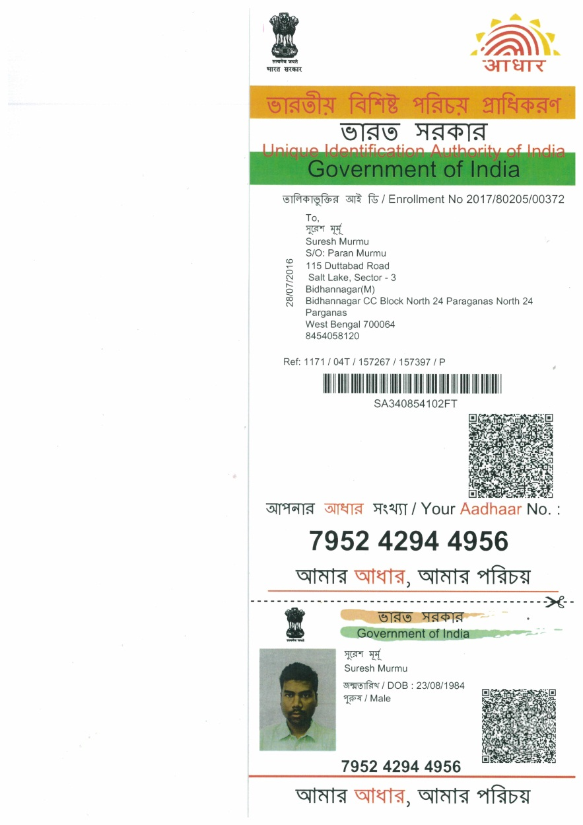
AADHAAR : GAME CHANGER
Biometric Digital Identity
Digital Financial Inclusion
G2P ‘Social Cash’ transfers
SAMPLE
Promoting Good Governance
Healthcare, education, telecommunications…
Tax Payment
Identify Missing Children
(for illustration purpose only)

Slide 14

India and Cambodia : Are they comparable ?
Poverty
Majority Lives in Villages
Informal Sector
High Cash Usage
Low Financial Literacy
Financial Exclusion
Private Money Lenders

Slide 15
SECTIONS
01
02
03
04
.
05
Introduction
India’s efforts towards Financial Inclusion
Aadhaar : Game Changer for India
Strategic Framework for Financial Inclusion in Cambodia : Suggested Approach
Conclusion

Slide 16
FINANCIAL INCLUSION in India : the Journey…
Phase II : 2005-2014
‘No-Frill Account’ (Simplified KYC)
Spreading Branch Network
Phase I : 1968-2005
Business Correspondents
Channelizing institutional credit to Priority Sectors
Lead Bank Scheme
Phase III : 2014 -
Aadhaar (Biometric ID)
PMJDY (Jan-Dhan A/c)
‘JAM’ Trinity

Slide 17
PHASE I : 1968-2005 [Focus on Credit]
ONE Bank
ONE District
Lead Bank Scheme
Definition of Priority Sectors
Limit : 40%
1968
1969
1971
1972
1974
1980
IDEATION
Priority Sectors
Informal Study Group
(RBI)
Lending to Priority Sectors : 33.3%

Slide 18

PHASE I : 1968-2005 [Focus on Credit]
Social
Infrastructure
Export Credit
8
1
Renewable
Energy
Agriculture
7
2
Small and Marginal Farmers
PRIORITY
SECTORS
Affordable
Housing
Micro, Small and
Medium Enterprises
6
3
5
4
Education
Weaker Section

Slide 19
PHASE II : 2005-2014 [Focus on Access]
Business Correspondents
25% of Private Bank branches in semi urban and rural centres
Banking services in 490,000 unbanked villages with population below 2000
'Basic Savings Bank Deposit Account'
Financial Inclusion Plans
Phase 1 : 2010-2013;
Phase 2 : 2013-2016
2005
2006
2009
2010
2011
2012
Liberalization of branch authorization policy
‘No-frills' account with simplified KYC
Open branches in Tier 3 - 6 centres without permission
Financial Literacy and Credit Counselling Centres
Banking services to 72,800 villages with population above 2,000
Enhanced banking services in Tier 2 centres

Slide 20
PHASE II : Focus on Access
547k
122k
221k
Business
Correspondents
[March 2017]
Bank
Branches
[June 2017]
ATMs
[September 2017]

Slide 21
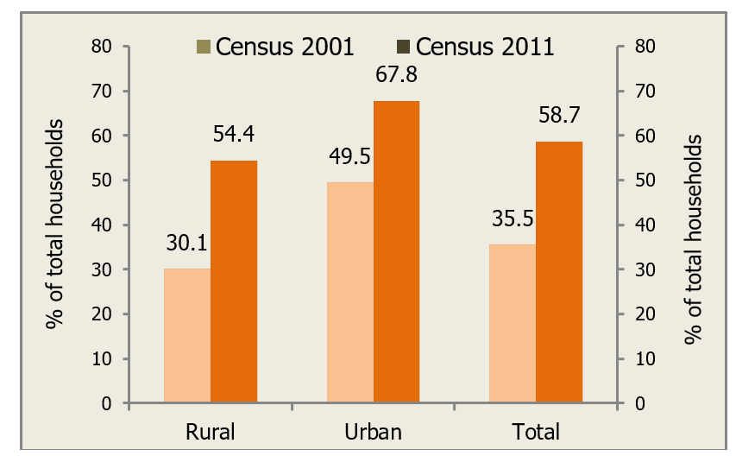
PHASE I & II : TAKING STOCK (1/2)
Availment of Banking Services in India

Slide 22
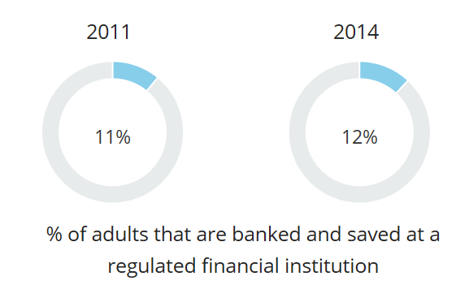
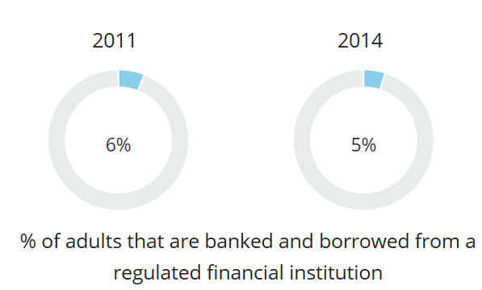
PHASE I & II : TAKING STOCK (2/2)
2011
2014
2011
2014
11%
12%
6%
7%
% of adults that are banked and saved
at a regulated financial institution
% of adults that are banked and borrowed from a regulated financial institution

Slide 23

PHASE I & II : CHALLENGES
POVERTY REDUCTION
FINANCIAL INCLUSION
FINANCIAL USAGE
Inadequate PRODUCTS [Credit Led]
High INOPERATIVE & DEFUNCT Accounts
FINANCIAL ACCESS
Lack of FORMAL IDENTITY
FINANCIAL LITERACY

Slide 24

PHASE III: August 2014 ~
Pension schemes for unorganized sector
Universal Access to
Banking Facilities
6
1
Basic banking accounts
Overdraft facility (US$ 75)
Debit card
Micro-insurance
5
2
4
3
‘Credit Guarantee Fund’
Financial Literacy Program
[Mission Mode]
Pradhan Mantri ‘Jan Dhan’ Yojana = National Mission on Financial Inclusion

Slide 25
PHASE III : What is so DIFFERENT ?
G-2-P ‘Social Cash’ (DBT)
APPROACH
3
4
1
2
creating BANKING HABITs
Leveraging on AADHAAR

Slide 26
SECTIONS
01
02
03
04
.
05
Introduction
India’s efforts towards Financial Inclusion
Aadhaar : Game Changer for India
Strategic Framework for Financial Inclusion in Cambodia : Suggested Approach
Conclusion

Slide 27


…the GAME CHANGER for INDIA
[in Sanskrit, means ‘Foundation’]
SAMPLE
Unique Identification Authority of India
Government of India
(for illustration purpose only)

Slide 28
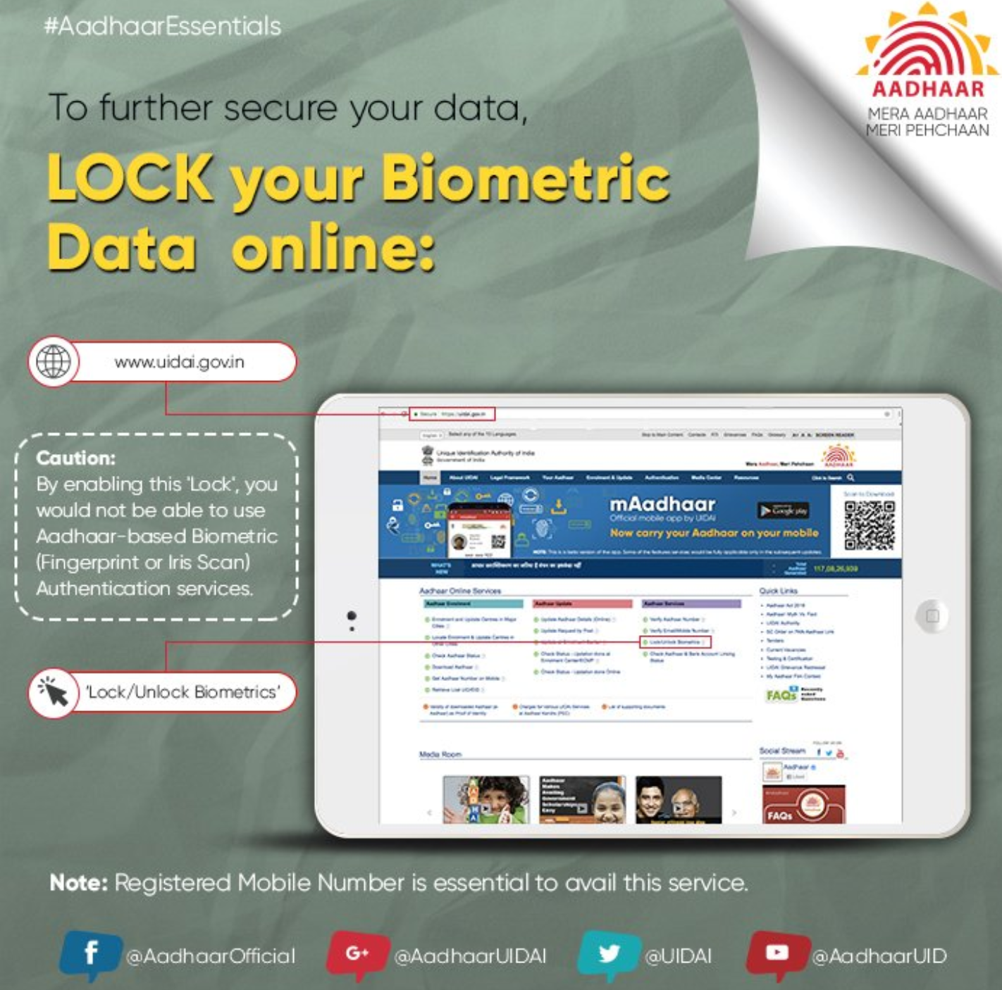
‘AADHAAR’ : the ‘FOUNDATION’
DEMOGRAPHICS INFORMATION
Name
Date of Birth (verified) or Age (declared)
Gender
Address
Mobile Number (optional)
Email ID (optional)
SAMPLE
BIOMETRIC INFORMATION
Ten Fingerprints
Two Iris Scans
Facial Photograph
12-digit random number (Unique)
(for illustration purpose only)

Slide 29


‘JAM’ TRINITY
357 million beneficiaries
eligible for ‘Social Cash’
1st MILE
Middle MILE
G2P E-transfer of ‘social cash’ US$28+ billion
274 million DIGITAL identification with AADHAAR
‘0’ MILE
1.19 billion
300+ million
Jan Dhan A/cs
GOAL!!
Last MILE
Beneficiary starts transacting using Aadhaar Enabled Electronic Payment Solutions
Message to beneficiary: Credit of ‘Social Cash’ into bank A/c

Slide 30
PHASE III: PMJDY Progress Report (1/2)
Position as on November 15, 2017 Figures in Million
Bank Type | Total No. of Beneficiaries | ..at rural branches | ..at urban branches | RuPay cards issued | Balance in beneficiaries' PMJDY A/cs (US$ in Million)
Public Sector Banks | 247.72 | 135.10 | 112.10 | 184.60 | 8,385.38
Regional Rural Banks | 49.30 | 41.70 | 7.60 | 36.20 | 1,830.75
Private Banks | 9.90 | 6.00 | 3.90 | 9.30 | 326.76
Total | 306.92 | 182.8 | 123.6 | 230.1 | 10,542.90
306.9
million
$10.5
billion

Slide 31
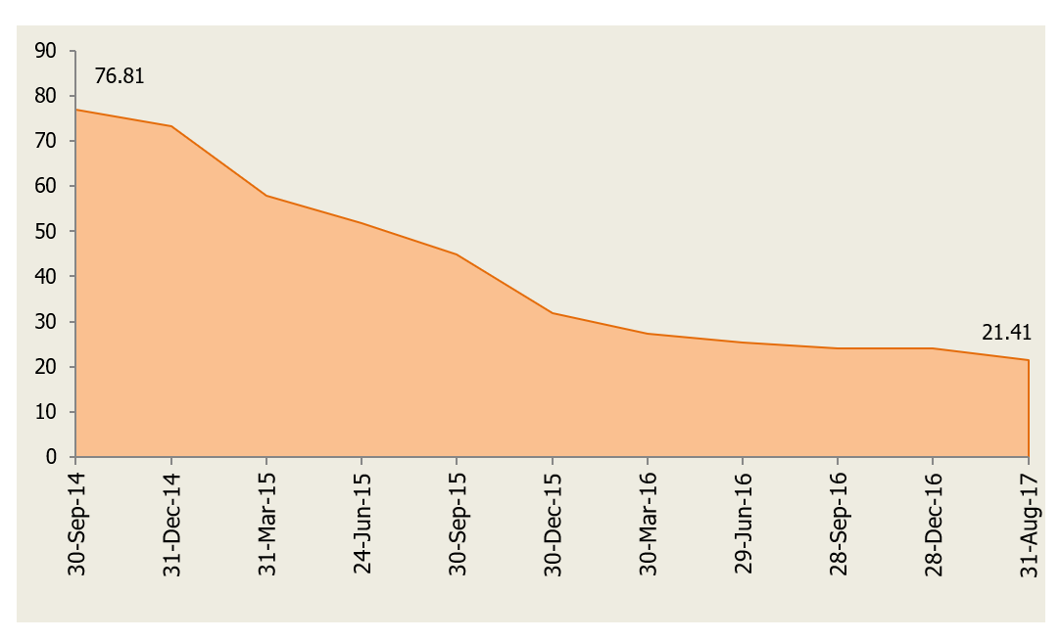
PHASE III: PMJDY Progress Report (2/2)
Trend of Zero Balance Accounts Under PMJDY (%)
21.4%

Slide 32
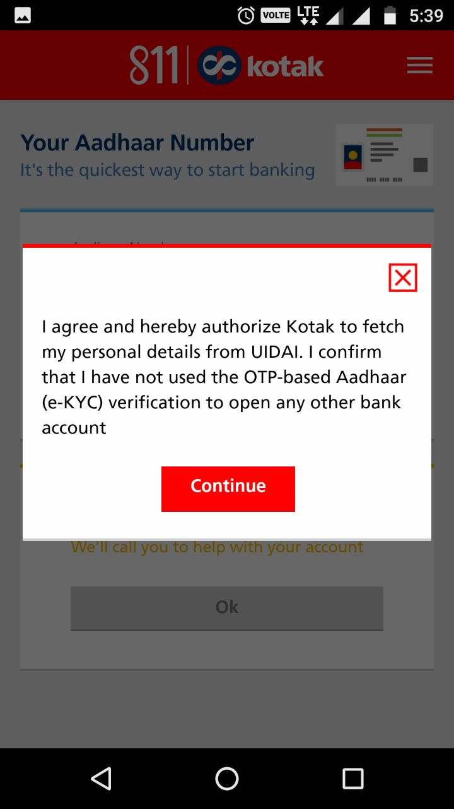
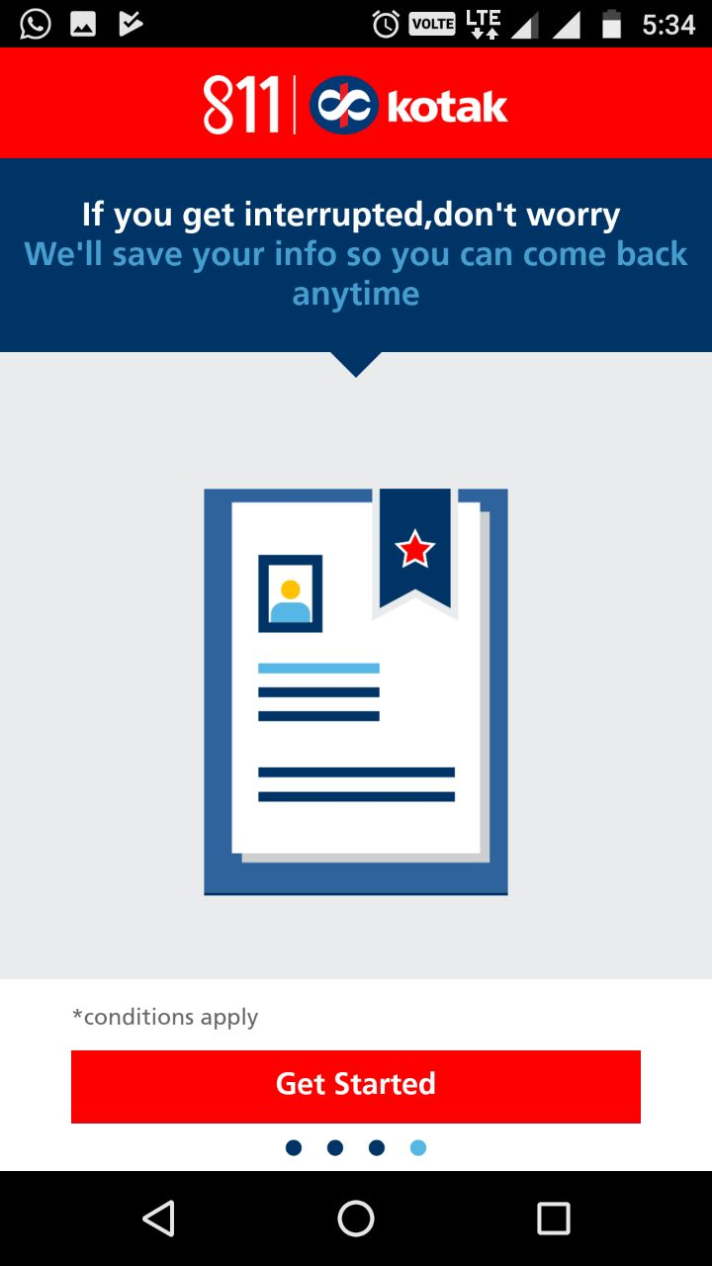
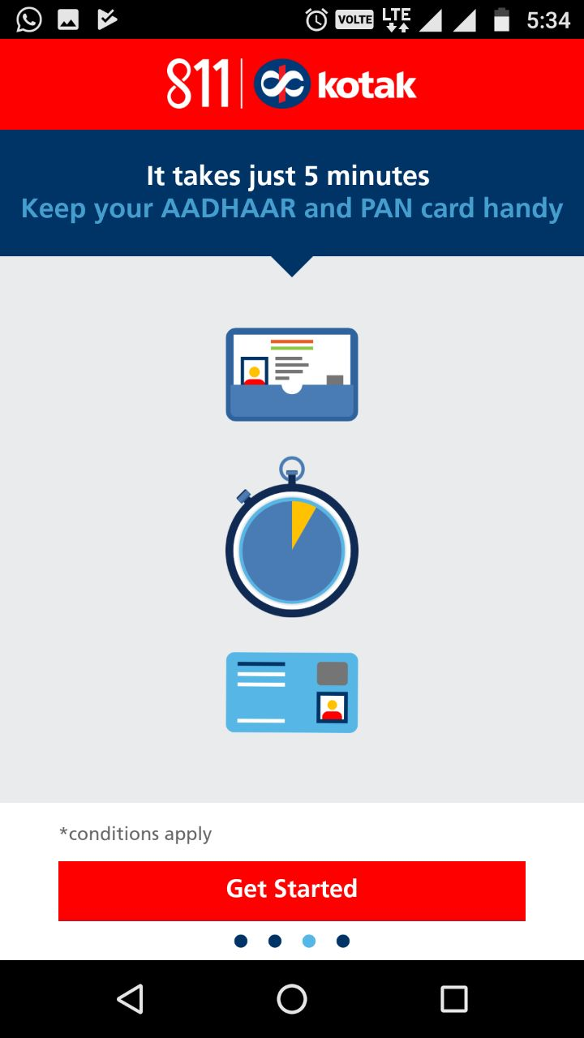
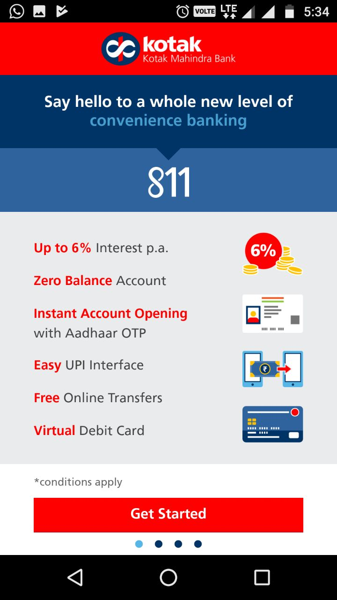
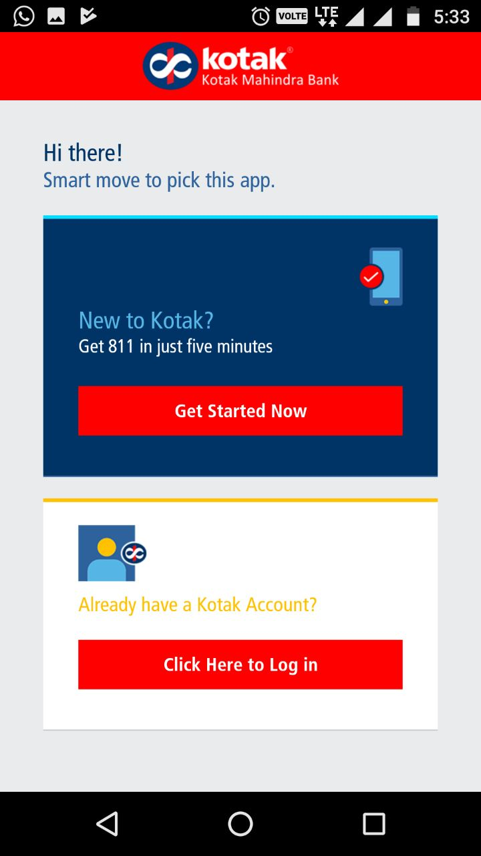
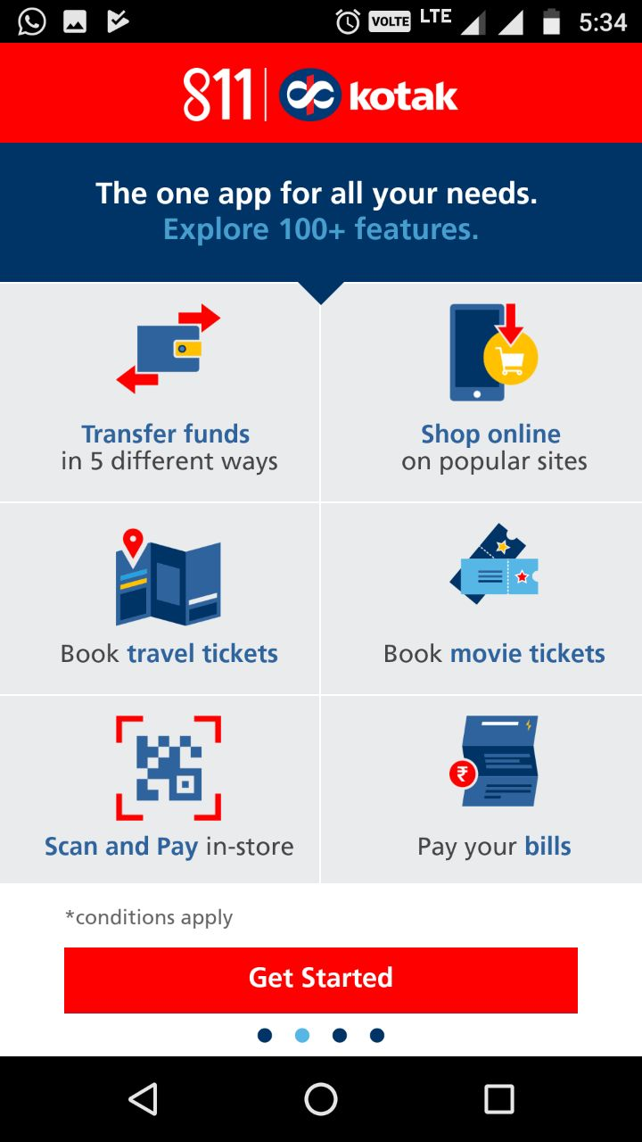
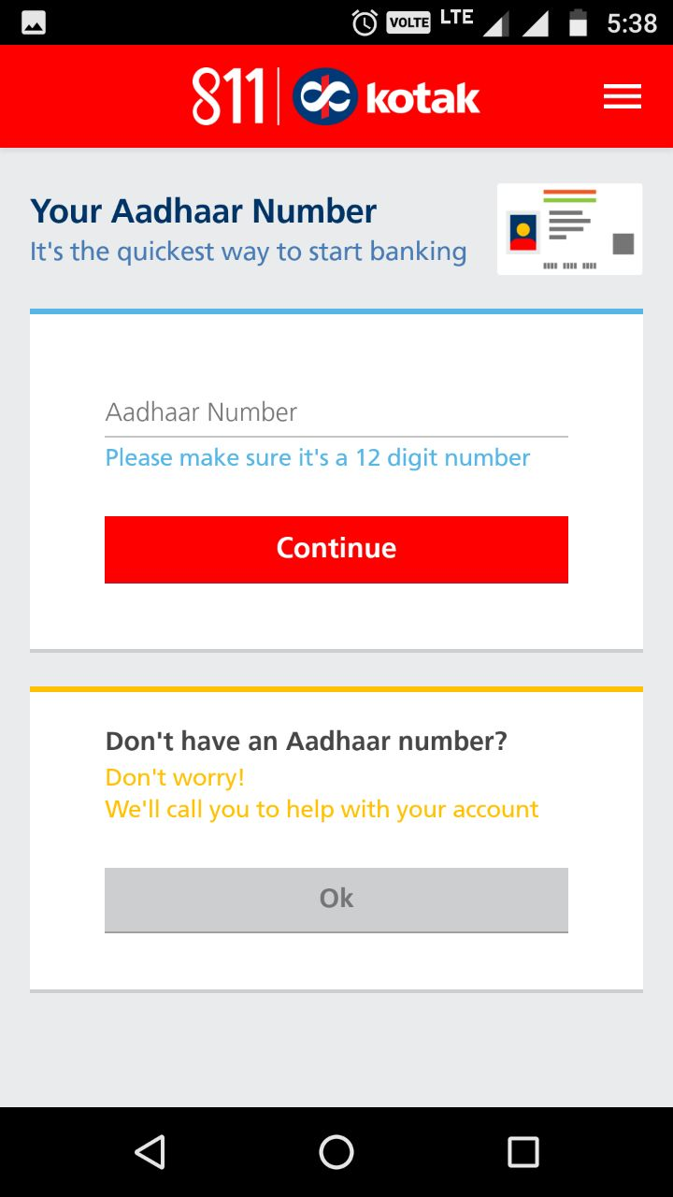
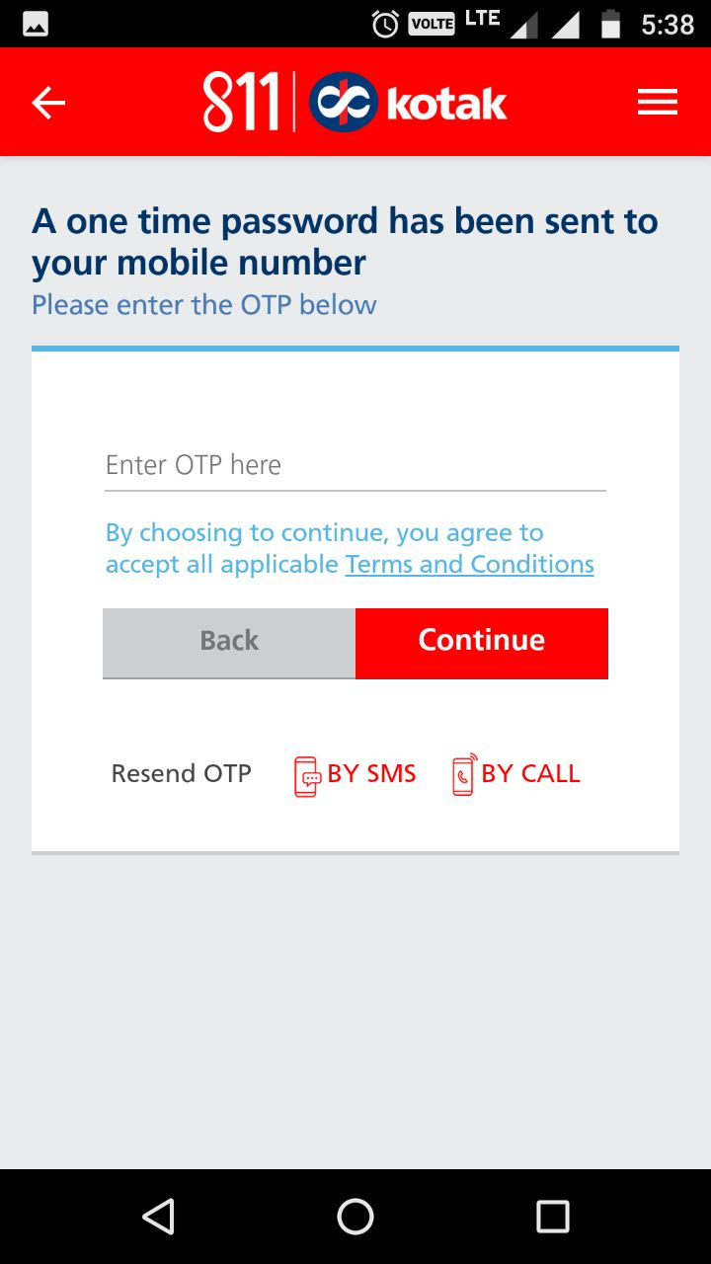
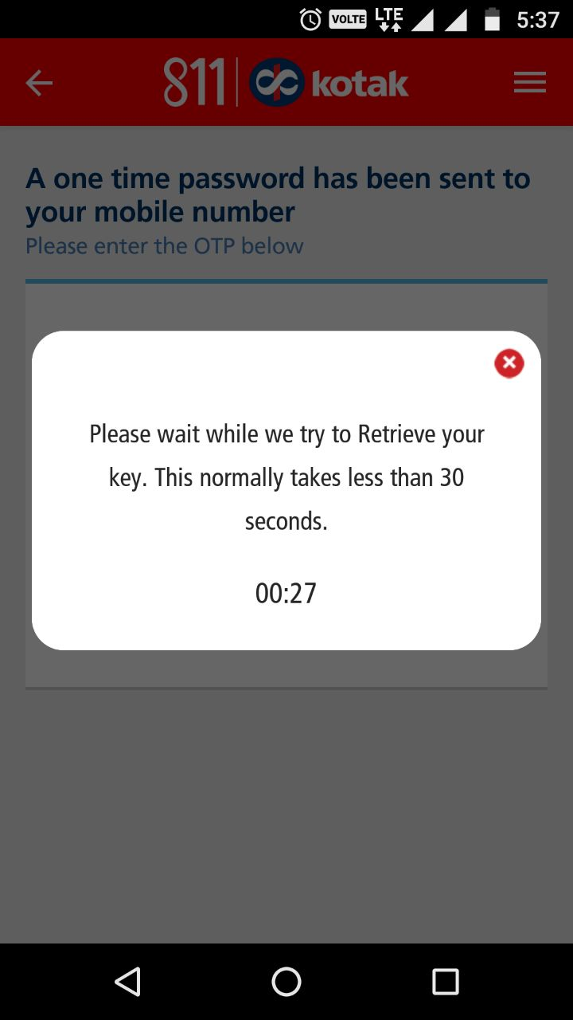
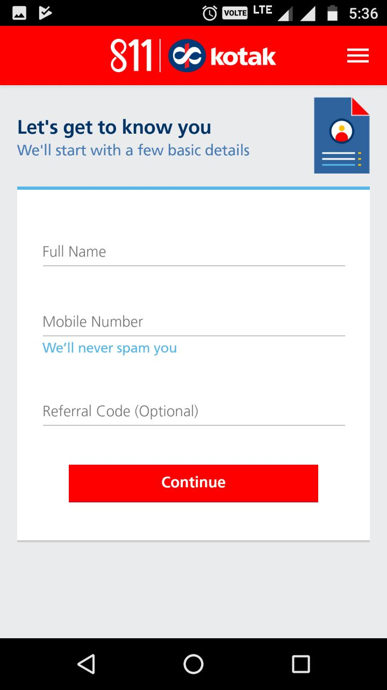
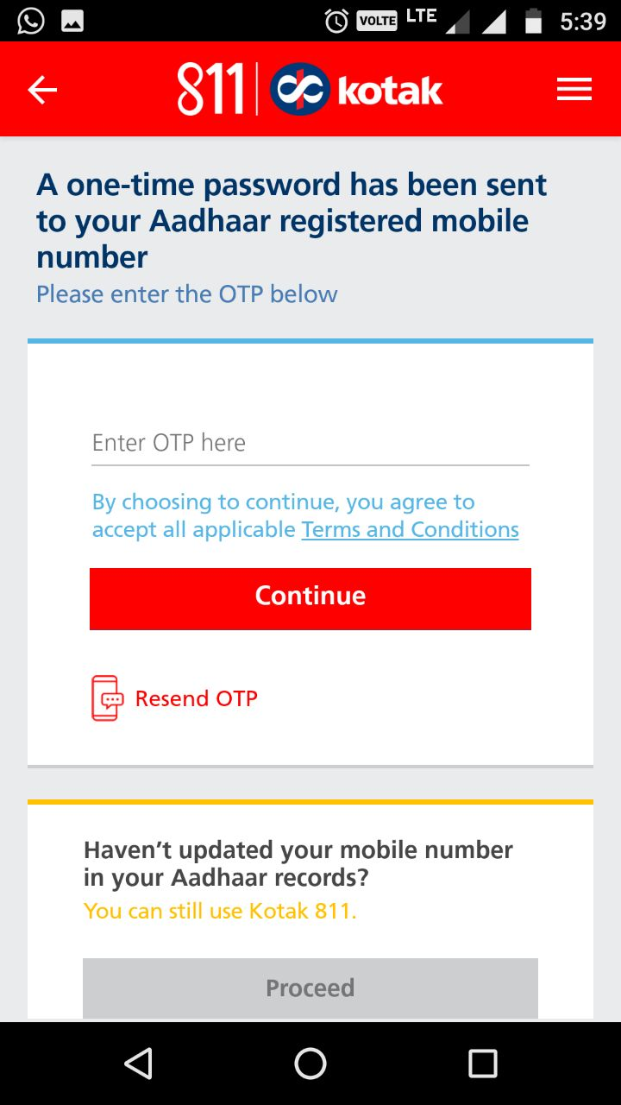
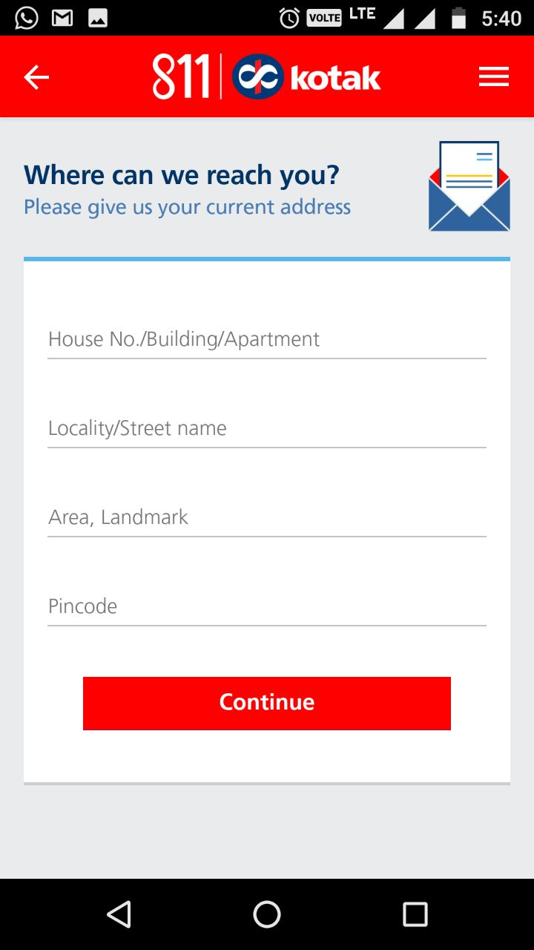
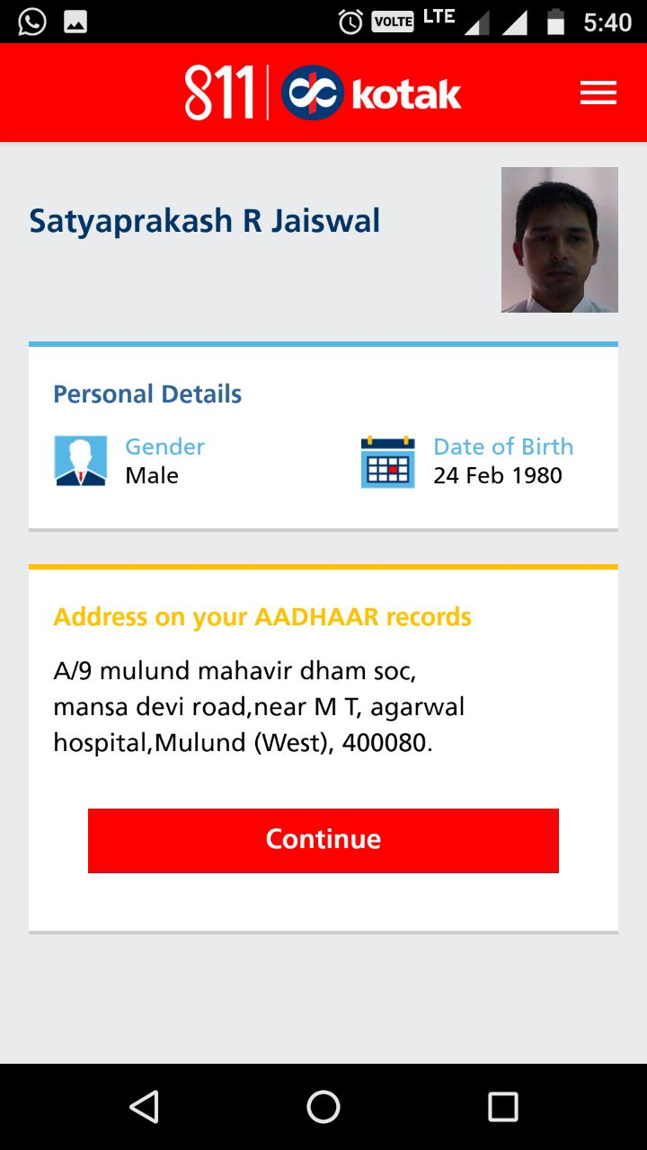
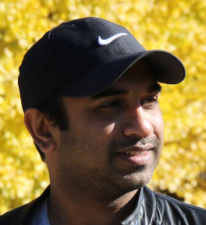
Uses of ‘AADHAAR’ : E-KYC & Account Opening
Reducing/eliminating risk of identity fraud, document forgery
Turn-Around-Time reduced from 2-3 days to 5 minutes
Reduction in the cost of customer on-boarding/acquisition by 2-3 per cent
Aadhaar enabled e-KYC estimated to help banks and telecom operators save upto US$1.5 billion additional costs over the next 5 years
Ratul Rana
(for illustration purpose only)

Slide 33




‘AADHAAR’ Ecosystem : How does it work?
Authentication
request
‘AADHAAR’
holder
Authentication Device
Authentication User Agency
Authentication Service Agency
Central Database
Computer kiosk
Handheld devices
Banks, NBFCs, MFIs
Telecom operators
Central & State Govt.
[infrastructure for secured network connectivity, etc.]
[Central Identities Data Repository]

Slide 34
Uses of ‘AADHAAR’ : E-KYC & Account Opening
Monthly e-KYC verification done by Banks through Aadhaar (# in Million)

Slide 35
Uses of ‘AADHAAR’ : BRANCHLESS BANKING
Branchless Banking
‘LAST’
MILE
Make Payments
Transfer Funds
Withdraw Cash
‘LAST’
MILE
AEPS : Aadhaar Enabled Payment System
branch-less banking by ‘banking correspondents’ using micro-ATMs and Aadhaar authentication
Using/Through
Mobile
Micro-ATMs
(Banking Correspondent)
Unified Payments
Interface (UPI) & Others
Aadhaar Enabled
Payment System (AEPS)
[some uses Aadhar]
[using Aadhar]
Bank Account linked to Mobile
Transfer/Credit ‘Social Cash’
‘MIDDLE’
MILE
Mobile
Connection
Bank
Accounts
Direct Benefit Transfers
UPI : Unified Payments Interface
instantaneous settlement (pull and push platform) of money between any two bank accounts using mobile
Aadhaar Payment Bridge System (APBS)
[using Aadhar]
Telecom Operator
Banks
Government
(State/Cen)
‘ZERO’
MILE
Digital identification
with Aadhaar
(‘Aadhaar Seeding’)
‘FIRST’
MILE
APBS : Aadhaar Payment Bridge System uses Aadhaar to identify beneficiaries eligible for receiving Government subsidies electronically
Electronic - ‘Know Your Customer’
AADHAAR – DIGITAL ID [BEDROCK]
Legal, Risk Management & Security Framework
Acts
Regulations
Notifications
Rules
Circulars

Slide 36
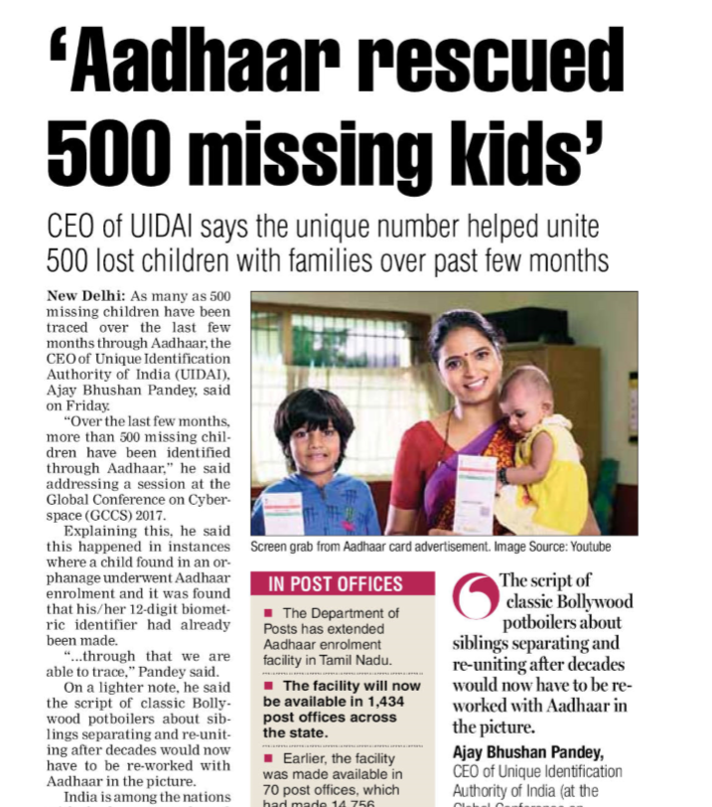
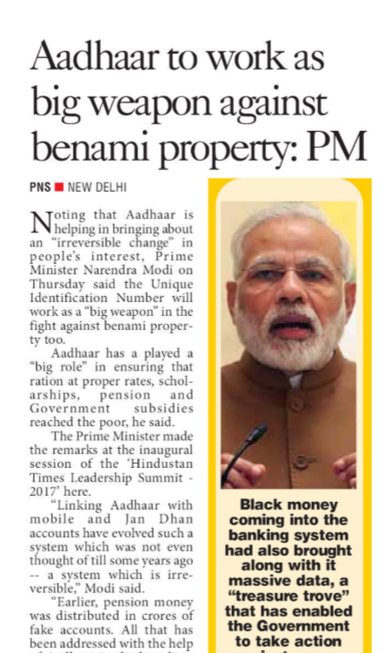
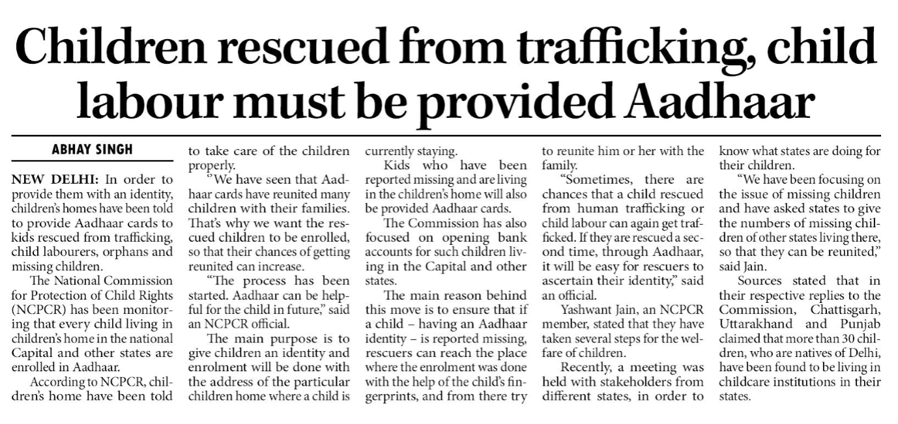
(for illustration purpose only)
Other EMERGING USES of AADHAAR

Slide 37

AADHAAR a ‘GAME CHANGER’ for INDIA? [W-I-P]
Enrolment
Authentication
E-KYC
1.19
13.5
3.87
billion
billion
billion
Aadhaar
Generated
Authentication
Done
E-KYC
Done
Cost
Savings
‘Social Cash’
US$
US$
US$
1.35
8.77
28.1
billion
billion
billion
Cumulative
Cost (2009-17)
Plugged LEAKAGES
in G2P transfers
G2P transfers*

Slide 38
PHASE I & II : CHALLENGES
POVERTY REDUCTION
FINANCIAL INCLUSION
FINANCIAL USAGE
Inadequate PRODUCTS [Credit Led]
INOPERATIVE & DEFUNCT Accounts
FINANCIAL ACCESS
Lack of FORMAL IDENTITY
FINANCIAL LITERACY

Slide 39
PHASE III: CHALLENGES being SOLVED…..[W-I-P]
POVERTY REDUCTION
FINANCIAL INCLUSION
FINANCIAL USAGE
Inadequate PRODUCTS [Credit Led]
INOPERATIVE & DEFUNCT Accounts
FINANCIAL ACCESS
Lack of FORMAL IDENTITY
FINANCIAL LITERACY

Slide 40
AADHAAR : CHALLENGES and CONTROVERSIES…
Operational Challenges
Data Security and Protection
Privacy Rights

Slide 41
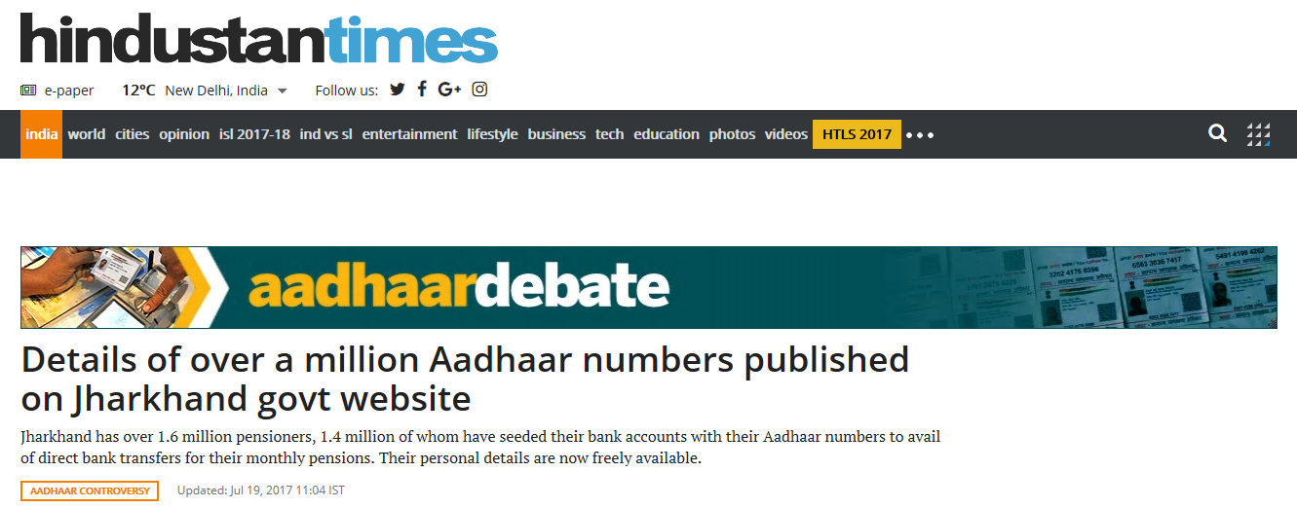
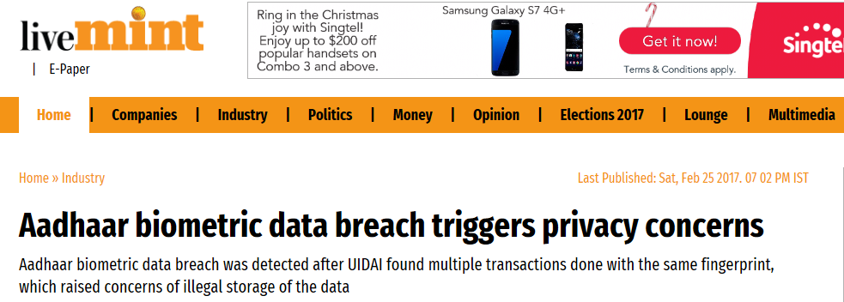

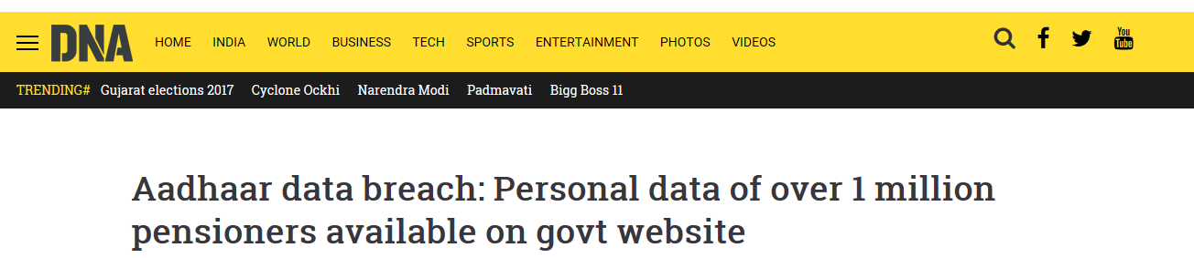
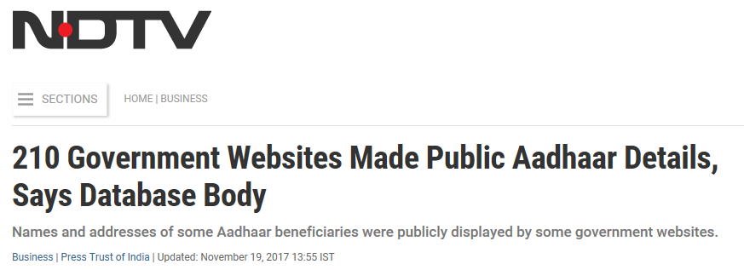
AADHAAR : DATA SECURITY
(for illustration purpose only)

Slide 42






AADHAAR : DATA SECURITY - MEASURES ADOPTED
ISO 27001:2013
AADHAAR DATA VAULT
Work-in-Progress :
National DATA PROTECTION framework
DATA PROTECTION BILL
“…despite an obligation to adopt data security safeguards, no database is 100% secured”
– Sri Krishna, former Supreme Court Justice
(for illustration purpose only)

Slide 43

AADHAAR violating the ‘Right to Privacy’?
‘Right to Privacy’ was
not an absolute right
and were subject to “reasonable restrictions”
(as applicable to Article 19 & 21)
‘Right to Privacy’
is a guaranteed “FUNDAMENTAL RIGHT”
(Article 21)
Supreme Court of India
(24-Aug-2017)
national security
preventing and investigating crime
encouraging innovation& spread of knowledge
preventing dissipation of social welfare benefits

Slide 44
SECTIONS
01
02
03
04
.
05
Introduction
India’s efforts towards Financial Inclusion
Aadhaar : Game Changer for India
Strategic Framework for Financial Inclusion in Cambodia : Suggested Approach
Conclusion

Slide 45
Strategic Framework for Financial Inclusion in Cambodia
Final Goal
Strategic Framework for Financial Inclusion
Intermediate Goal
POVERTY REDUCTION
G2P Cash Transfers and affordable financial services through ICT
FINANCIAL INCLUSION
Leveraging on ICT and Biometric technologies to improve access
FINANCIAL USAGE
Focus on ‘Digital Financial Literacy’
FINANCIAL ACCESS
FINANCIAL LITERACY

Slide 46
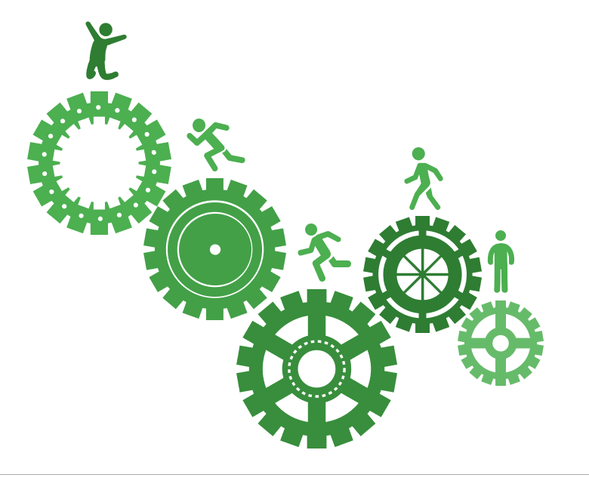
INTEGRATED APPROACH
Poverty Reduction
Social Schemes & Programs of INTERNATIONAL AGENCIES
PARTNESHIPS with ICT Companies, Card Networks…
Strategic Framework for Financial Inclusion
Social Schemes & Programs of the GOVERNMENT

Slide 47

GOAL CONGRUENCE : Leveraging on Interlinkages
National Social Protection Policy Framework (2016-2025)
National Strategic Plan for Identification (2017-2026)
(General Department for Identification, Ministry of Interior)
ICT Master Plan 2020
(KOICA & Ministry of Post & Telecommunications)
Cash Transfer Pilot Program Focused on Maternal and
Child Health and Nutrition (World Bank, Ministry of Interior, NCDD-S, et.al)
Identification of Poor Households (IDPoor)
(Ministry of Planning, WFP, GIZ)
Cash for Work Program - EFAP
(Ministry of Economy & Finance & ADB)

Slide 48
GOAL CONGRUENCE : Leveraging on Interlinkages
Cash scholarships for school students
Ministry of Education, Youth and Sports (MoEYS) and the UN World Food Programme
Health Equity Fund schemes
Several Multilateral Agencies
‘Out-of-School’ Cchildren initiative
MOEYS and UNICEF
EDF Scholarship (Material, Student Uniform and Cash)
EDF-Japan [Minsai Center Japan]
Various Projects
Japan Fund for Poverty Reduction
Various Multilateral Agencies
[ODA : $ 263 mn out of $756 mn]

Slide 49
SECTIONS
01
02
03
04
.
05
Introduction
India’s efforts towards Financial Inclusion
Aadhaar : Game Changer for India
Strategic Framework for Financial Inclusion in Cambodia : Suggested Approach
Conclusion

Slide 50
MESSAGES, that we leave behind…
Integrated approach
(Regulatory framework, IT Infrastructure, Identification system, various Social Schemes & Programs …)
Partnerships
(Government, Financial Institutions, Development Partners, MNOs, ISPs, Global IT firms, Card networks….)
Developing an ECOSYSTEM
Using Biometric Identity
e-KYC, Simple and Secured transactions
Reducing operating costs; Improving TAT
Digitizing G2P“ Social Cash” Transfers
SAVINGS for Government; Promoting Good Governance; Creating ‘Banking habit’ for B-o-P

Slide 51
SCOPE for further RESEARCH…
…’knowing the KNOWNS’
Mastercard Lab for Financial Inclusion (Africa)
Universal Financial Access 2020
Pledges : Financially excluded adults
VISA : 500 million
MasterCard : 500 million
Other Country Cases: Example : CHINA…
China Financial Inclusion and Education (Jinhui Project) International Demonstration Zone
Mobile phone-based financial education to
5++ million in 3 years
WeChat, Alipay and QR Code (‘Payments Aspects of Financial Inclusion’)

Slide 52
Role of Technology in Promoting Financial Inclusion
Lessons from India
[Academic Report]
by -
Ratul Rana
Sumitomo Mitsui Banking Corporation* [Singapore]
Shotaro Kumagai
Japan Research Institute* [Tokyo]
* Sumitomo Mitsui Financial Group (SMFG) companies

Slide 53
DISCLAIMER
The two authors are currently working with Sumitomo Mitsui Banking Corporation (SMBC) and Japan Research Institute (JRI), respectively – subsidiary entities of Sumitomo Mitsui Financial Group (“SMFG”), Japan.
All views, opinions, findings, and conclusions or recommendations expressed in this ‘Academic Paper’ are strictly and entirely that of the individual authors and the same does not represent the views/stance of the SMFG and/or its subsidiary/affiliate organizations in any manner and form whatsoever.
SMFG and/or its subsidiary/affiliate organizations take no responsibility for any errors or omissions in, or for the correctness of, the information contained in this Paper.
The authors bear complete and unconditional responsibility of the correctness and for any/all errors & omissions in the Paper. All views, opinions, findings, and conclusions or recommendations expressed in this ‘Academic Report’ are done with the sole intention of encouraging further deliberation and debate on the subject.
All graphics, pictures, logos, etc. are used with the limited intention of creating a better visualisation and understanding. Such usage does not represent any form of endorsement by the authors and/or their affiliated organisation.

Slide 54
ANNEX

Slide 55
Institutions driving Financial Inclusion in INDIA
Ministry of Finance
Department of Financial Services
RESERVE BANK OF INDIA (RBI)
Scheduled Commercial Banks
Non-Banking Finance Companies
All India Financial Institutions
Universal Banking License
Investment Company
Export Import Bank of India
6,366
Public Sector Banks
21
Housing Finance Companies
64
National Housing Bank (NHB)
Private Sector Banks
21
Asset Finance Company
National Bank for Agriculture and Rural Development (NABARD)
401
Foreign Banks
45
Loan Companies
4,283
Differentiated Banks
Small Industries Development Bank of India (SIDBI)
Micro Finance Institution
82
Payments Banks
4
Small Finance Banks
Core Investment Company
47
Micro Units Development & Refinance Agency Ltd (MUDRA)
9
Other Banks
Infrastructure Finance Company
8
Urban Co-op Banks
1,574
Factoring Company
6
Infrastructure Debt Fund
4
High /direct Involvement
Low/indirect
Involvement
Rural Co-op Banks
93,913
Regional Rural Banks
Others (SC, RC, MGC)*
19
56
Number of Entities
[Latest available position]
Local Area Banks
*Securitization Company (SC); Reconstruction Company (RC); Mortgage Guarantee Company (MGC)
3

Slide 56
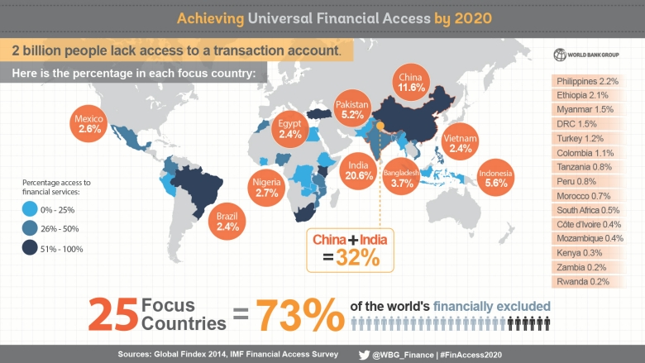

Slide 57
Strategic Framework for Financial Inclusion in Cambodia
ACTIVITIES
GOALS
CHALLENGES
KEY ENABLERS
KEY PLAYERS
Step 1 : Corner Stone
Financial Education/Awareness
Continuous Outreach Programs
Digital Literacy, Cyber Hygiene lessons
National Mission; Legislation
Regulatory Policies & Procedures
Risk Management
Security, Storage & Protection
Data Handling & Protection
Payment/Settlement Systems
Financial Inclusion Fund
Payment & Settlement Gateways (eg., LVPS, FAST, RTGS, central shared switch for ATM/POS and other Retail payments systems)
Remittance platforms
Mobile Banking Applications
Communication Infrastructure
Digital Infrastructure (alternate solutions to ATMs and POS, like M-POS, QR Code, Social medial platforms)
Strengthening of Consumer Protection; Right to Suitability
Banking Ombudsman
Cyber Security Framework
Data Storage and Protection
Deposit Insurance; Insurance for Digital Frauds
Credit Bureau
Central Data Repository (Digitized Beneficiary database)
Monitoring and Supervision
Capacity Development
Greater engagement of :
Government Agencies; National bank of Cambodia; Cambodia Post, etc.
Private sector participation of Banks, MFIs, MDIs, Mobile Network Operators; Internet Service Providers; Banking Correspondents and Facilitators; E-Commerce firms
Development Partners : Multilateral Agencies – WB, ADB, IFC, UN, UNCTAD, etc., and developed countries for technical and financial support
Civil Society – Labor Unions; Teachers; Merchants; Schools & Colleges; Malls
ASEAN financial integration;
Supervisory Colleges with other Central Banks (HKMA, MAS, RBI, BOK, etc.)
Collaboration with global digital firms/IT Companies, FinTech (eg., Cyberport in Hong Kong; ‘10,000 startups’ in India)
FINANCIAL
LITERACY
Step 2 : ‘Making Access Possible’
Open Accounts with Banks/MFIs
Access to FIs and Financial Products
Promote women’s access to finance
Measure Progress; Repeat Step 1
Sustaining momentum on an ongoing and continuous basis; Ownership & engagement issues; Cost effectiveness
FINANCIAL
ACCESS
Step 3 : Usage of Financial Access
Social cash transfers; Remittances
Banking products – savings, loans
Micro-insurance - crop, life
Encourage women participation
Measure Progress; Repeat Step 1
Know Your Customer (KYC)
Overcoming perception that “poor not bankable”
FINANCIAL
USAGE
Step 4 : Intermediate Goal
Tracking Access/Usage, Measure quality
Measure Progress; Repeat Step 1
Inoperative accounts
“Creating/Changing habits”
Digitization of Merchants
FINANCIAL
INCLUSION
Step 5 : FINAL Goal
Macro : Financial Stability
Impact on Dollarization; Riel
Micro : over indebtedness
POVERTY
REDUCTION
Integration of Poverty Reduction Programs with Financial Inclusion

Slide 58
PMJDY : FUNDING the Account (DBT)
Direct Benefit Transfer (DBT) : January 01, 2013 - March 31, 2017
Name of the Scheme¹ | No. of Beneficiaries (Million)² | No. of Beneficiaries data seeded with Aadhaar (Million) | Beneficiaries seeded with Aadhaar (%) | Fund Transferred (US$ in Billion) |  |  | Fund transfer using Aadhaar Bridge Payment (%)
 |  |  |  | Using Aadhaar Bridge Payment | Electronic Fund Transfer W/o Aadhaar Bridge Payment | Total
MGNREGS | 111.5 | 91.1 | 82% | 2.05 | 10.74 | 12.80 | 16%
NSAP | 27.6 | 14.4 | 52% | 0.46 | 2.73 | 3.19 | 14%
PAHAL³ | 187.3 | 153.2 | 82% | 5.47 | 2.54 | 8.01 | 68%
Scholarships | 22.7 | 11.8 | 52% | 0.13 | 3.23 | 3.37 | 4%
Other Schemes | 8.1 | 3 | 37% | 0.04 | 0.70 | 0.74 | 6%
Total | 357.2 | 273.5 | 77% | 8.20 | 19.90 | 28.10 | 29%

Slide 59
Trend of Enrolment of Aadhaar

Slide 60
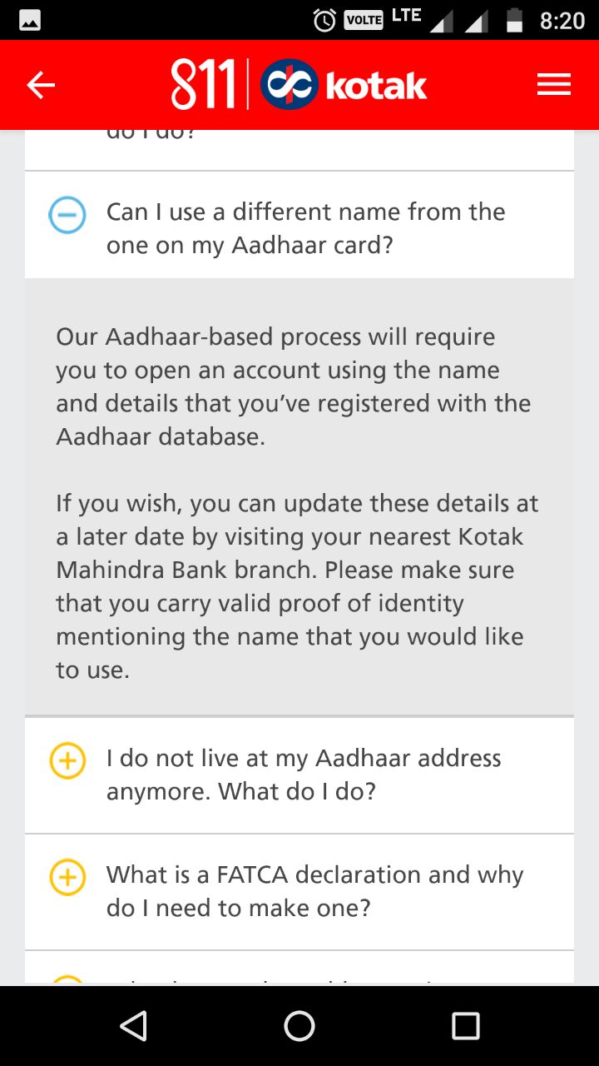
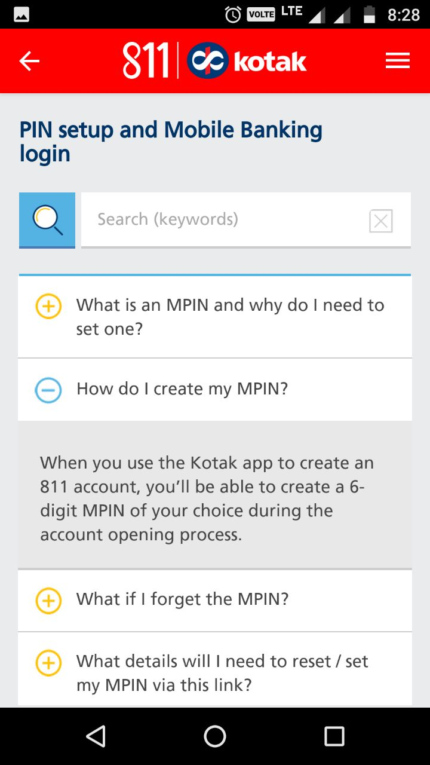
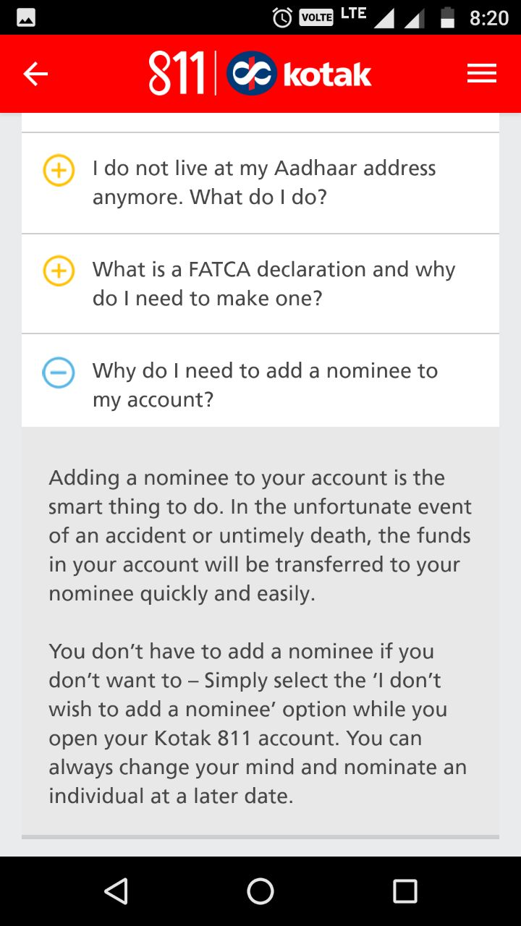
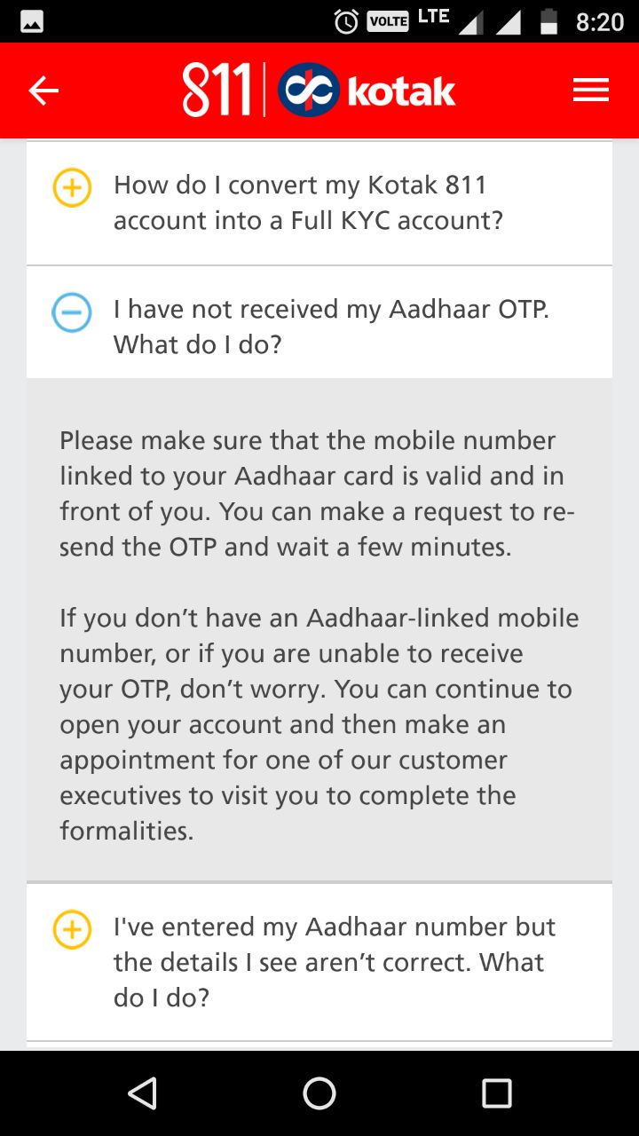
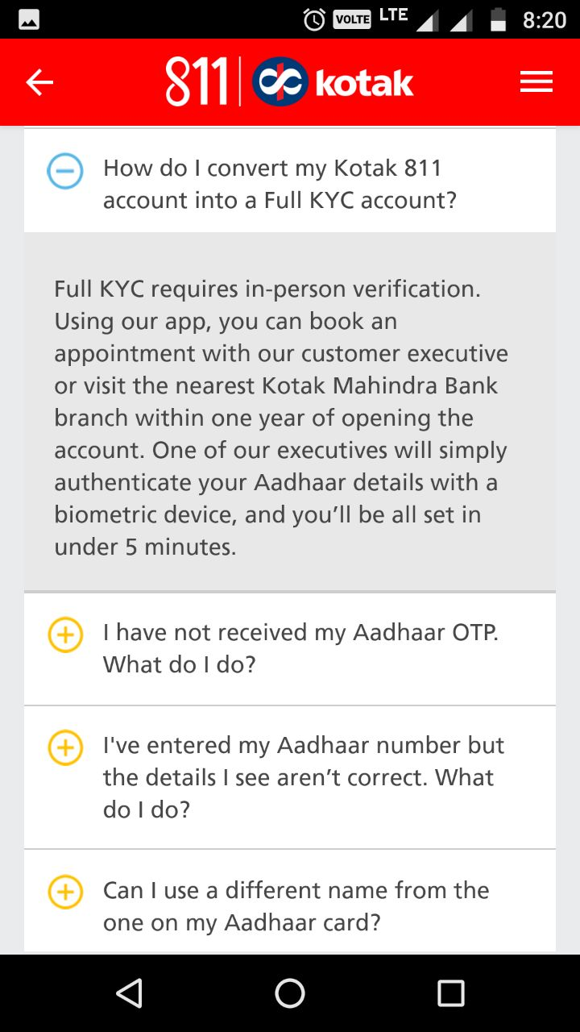
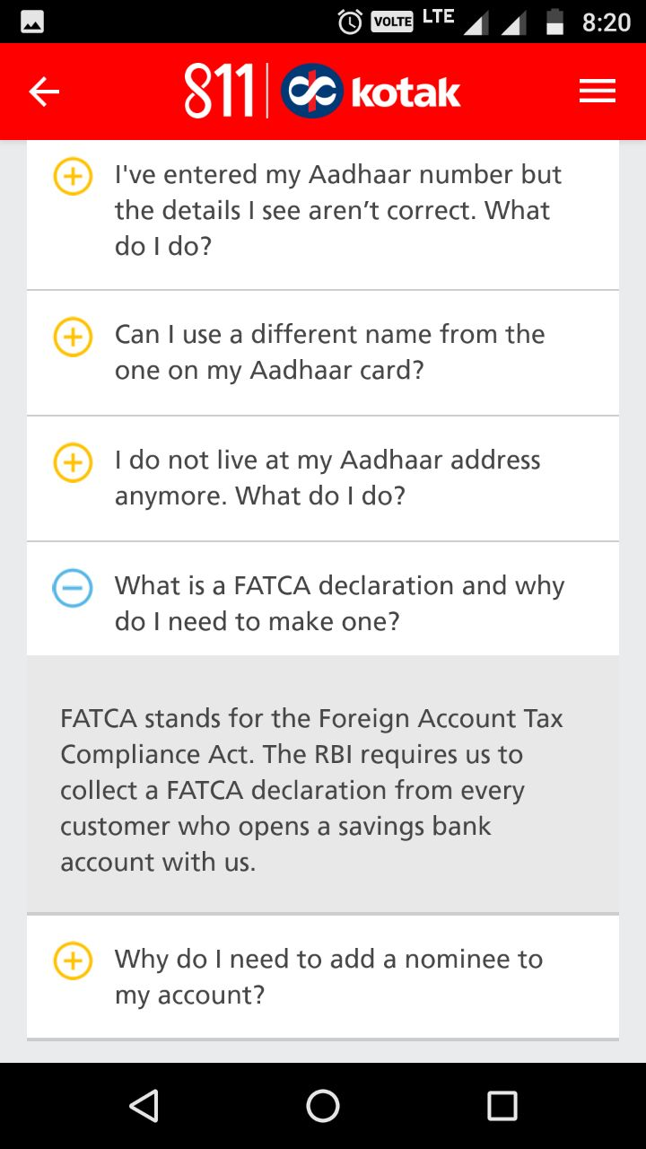
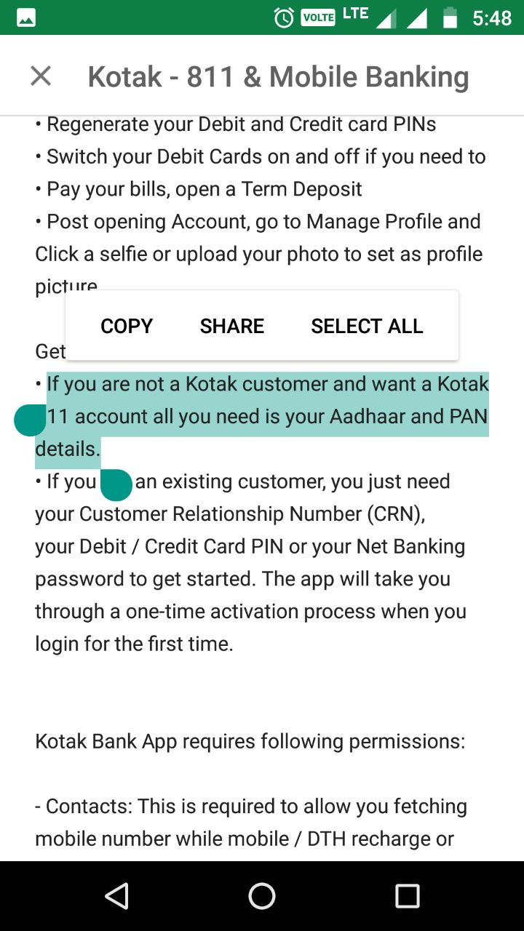
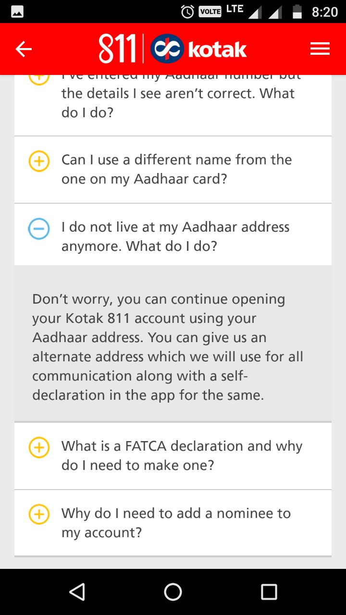
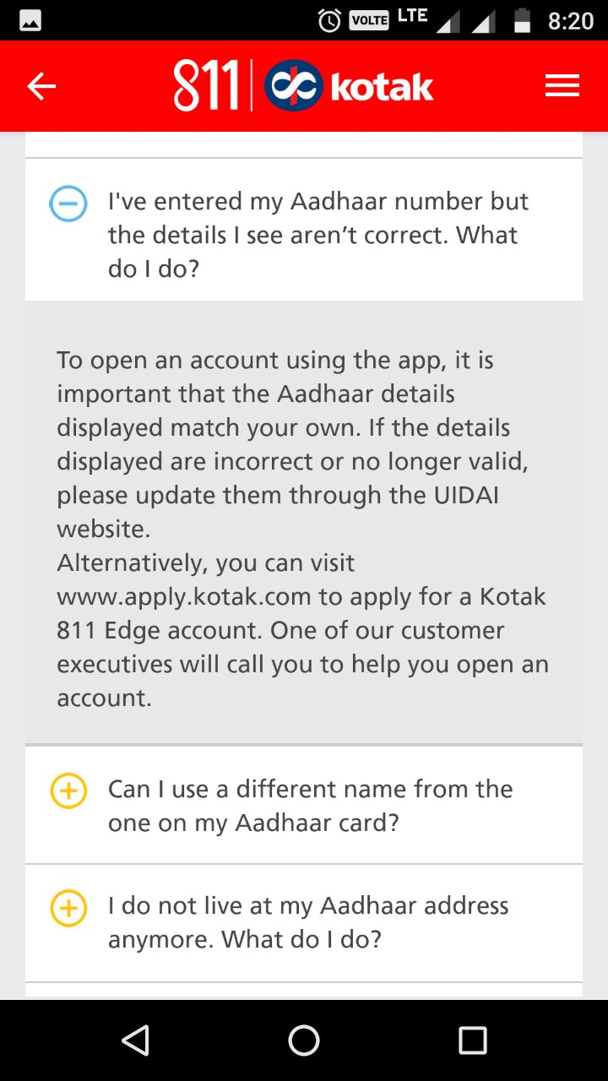
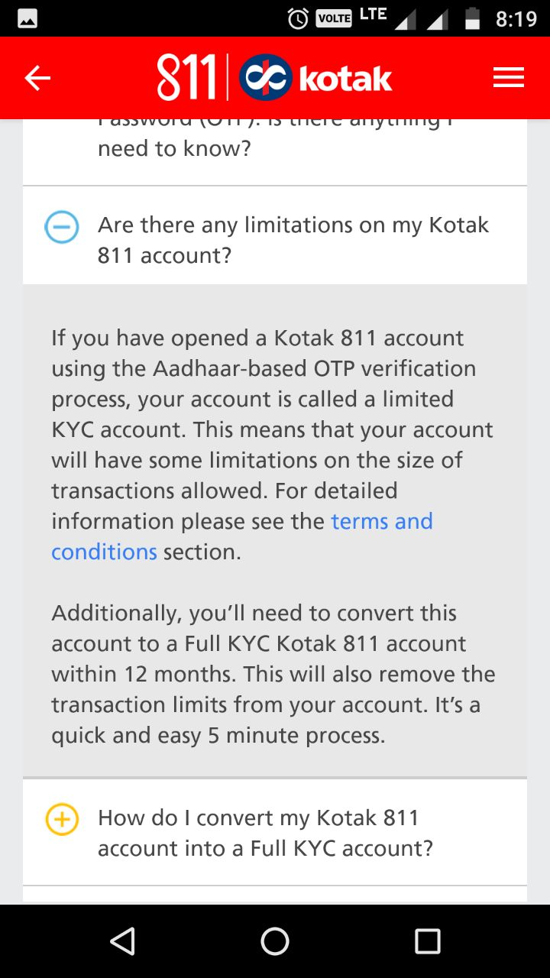
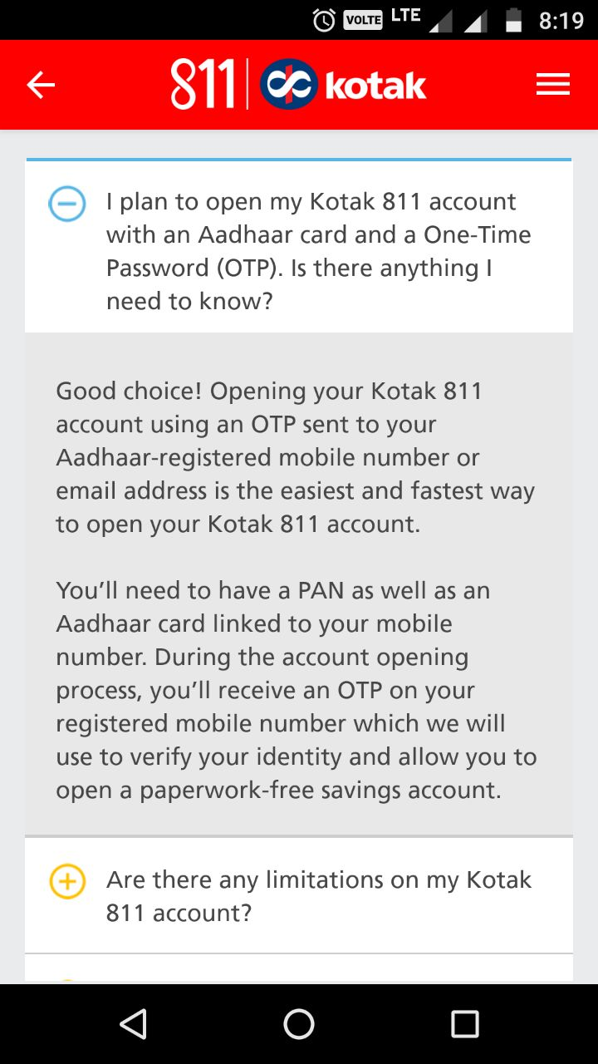
Uses of ‘AADHAAR’ : E-KYC & Account Opening (2/2)

Slide 61
‘Digital Payment’ solutions in India
Year | Type of Digital Payment Solutions | Features
2010 | Immediate Payment Service (IMPS) | Instant, 24X7, interbank immediate electronic fund transfer service through multiple channels such as Internet banking, mobile banking
2014 | National Unified USSD Platform | Immediate low value remittances using mobile phones - both basic feature and smart phones
2016 | Unified Payments Interface (UPI) | Common Mobile Application developed by the NPCI. UPI uses mobile as the primary device for all (push & pull) payments including P2P, P2E, and E2P. Uses Aadhaar number, mobile number, card number, and account number in an unified way
2016 | Bharat Interface for Money (BHIM) | Common Mobile Application launched/operated by NPCI. BHIM is an upgraded version of UPI. Real time fund transfer using a single identity like mobile number or name.
2017 | Bharat QR | Payments between P2E wherein physical POS is not required; only virtual POS
2017 | Aadhaar Pay | Payments on the basis of fingerprints/Aadhar Number; No need for mobiles, payment gateways like MasterCard or VISA

Slide 62
Remonetization’ after ‘Demonetisation’
$236 bn
rapid remonetization
Demonetization

Slide 63
PHASE I : Focus on Credit
Bank Group-wise Priority Sector Advances [US$ in billion]

Slide 64

Relative Size of Banks and Non-Banks
Note.
All figures are as on March 31, 2016
FX rate as of March 31, 2016 : 1US$ = INR 66.2475
Total Assets of ”Banks” does not include data relating to 1574 Urban Cooperative Banks and 56 Regional Rural Banks
Data on “Total Assets of NBFCs” pertains to 421 NBFCs {162 Deposit Taking + 259 Non-Deposit taking NBFCs}.

Slide 65
PHASE II : Focus on Access
Bank Branches [June 2017]
Centres | Population Group [Census 2011] | Public Sector Banks (21) | Private Sector Banks (21) | Foreign Banks (45) | Total
Metro | 1 million ++ | 21,570 | 7,433 | 243 | 29,246
Urban | 0.1 - 0.99 million | 19,782 | 5,473 | 37 | 25,292
Semi-Urban | 10,000 – 99,999 | 25,934 | 8,027 | 10 | 33,971
Rural | < 99,999 | 29,171 | 4,912 | 9 | 34,092
Total |  | 96,457 | 25,845 | 299 | 122,601
122k

Slide 66
PHASE II : Focus on Access
ATMs [September 2017]
Centres | Public Sector Banks (#21) | Private Sector Banks (#20) | Foreign Banks (#7) | Total (Banks) | White Label (#8) | Grand Total
Metro | 33,567 | 24,925 | 733 | 59,225 | 2,015 | 61,240
Urban | 41,392 | 15,467 | 168 | 57,027 | 1,807 | 58,834
Semi - Urban | 42,293 | 14,199 | 17 | 56,509 | 4,481 | 60,990
Rural | 29,655 | 4,774 | 16 | 34,445 | 6,044 | 40,489
Total | 146,907 | 59,365 | 934 | 207,206 | 14,347 | 221,553
221k

